Slide 1

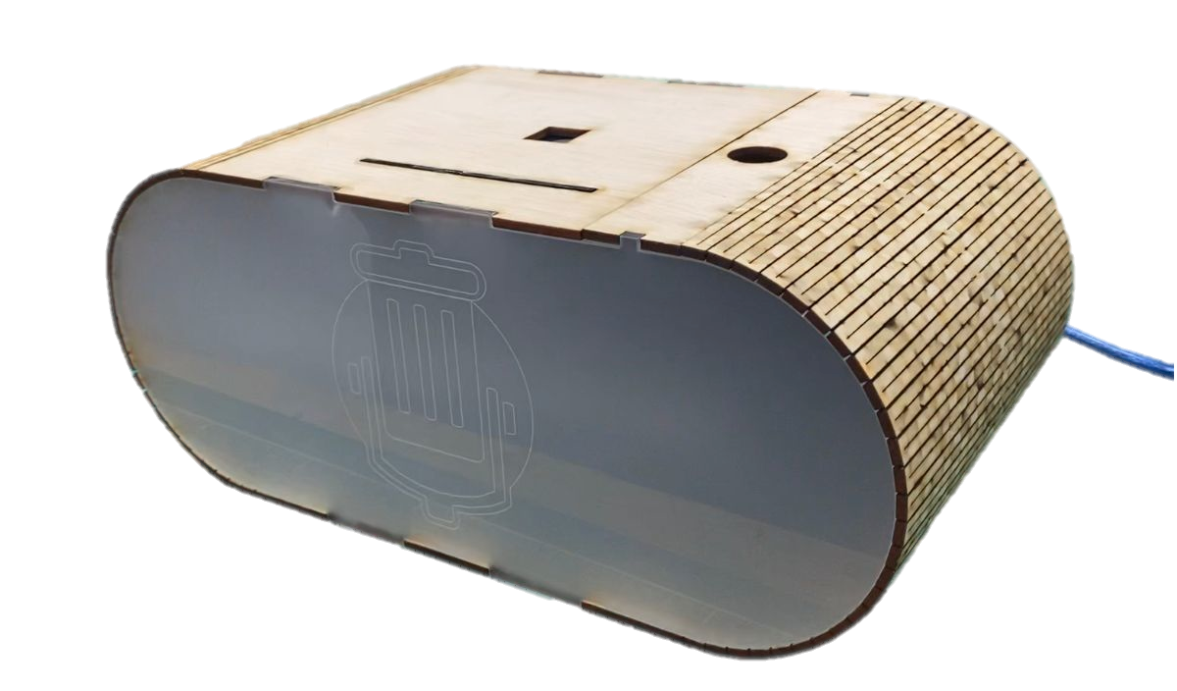
RGB Music Box
With a touch of a finger from the touch sensor, the music could start and stop playing as the person wants. LED lights light up to the beat of the music playing from the speaker.
Features:
Start/Stop enabled touch sensor (input)
Music playing via speaker (output)
Sound-reactive RGB lights (output)
Program:
Arduino IDE
Materials:
Plywood
Black Acrylic
Matte/Frosted Clear Acrylic
Components:
Arduino Uno
Touch Sensor
Sound Sensor
DFPlayer Mini with MicroSD
Speaker
LED Strip
Techniques used:
3D printing
Laser cutting
Fusion360
Arduino coding
Soldering
EP1000 22/23 Sem2
Joseph Martin C. Tiamzon
P1907492

